Slide 1


LAVACADOS
Team Members
Kendra McPherson,
Nijhae Nolan,
Nikki Plassenthal

Slide 2
Table of Contents
Project Introduction
Methods
Background
Results
Summary, and Questions

Slide 3
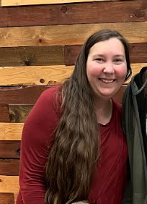
Kendra McPherson
Military seamstress part time and a paraeducator full time.
Currently working with a past student
Went to school for Elementary and Special Education

Slide 4

Nijhae Nolan
New Jersey native
Piscataway High School Graduate
Networking and Marketing work experience.
Currently employed with TGI Fridays as a Manager
Notes:
Hi! -Jhae

Slide 5



Nikki Plassenthal
I am a florida realtor, certified math teacher, & I have worked in Healthcare & talent acquisition. I began my career as an artist & photographer in the navy
B.A. Fine Arts
B.A. Art History & Archeology
Math Educator’s Certificate

Slide 6
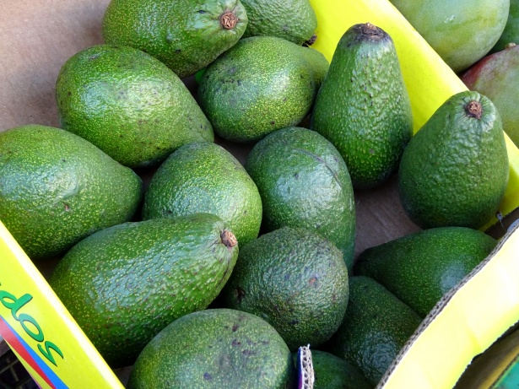
Project Introduction
LAVACADOS AVOCADOS
COMPARE THE THREE CITIES OF CHICAGO, COLUMBUS, & TAMPA.
NIKKI COMPARED THE AVERAGE PRICE & COST OVER THE SEASONS
NIJHAE COMPARED TYPE (ORGANIC OR NON-ORGANIC) & PRICE OVER THE SEASONS
KENDRA COMPARED TYPE & TOTAL VOLUME OVER THE YEARS 2015-2017
Notes:
The avocado has become one of the most popular fruits in the US in recent years, with increasing interest due to its health benefits and versatile use in cooking. In order to gain more insight on the consumption of avocados , as well as how they may affect consumers and producers alike we dove into some data from the year 2015 - 2017 and drew some conclusions on the type, volume, cost and price of the avocados being sold in some regions of the US!

Slide 7
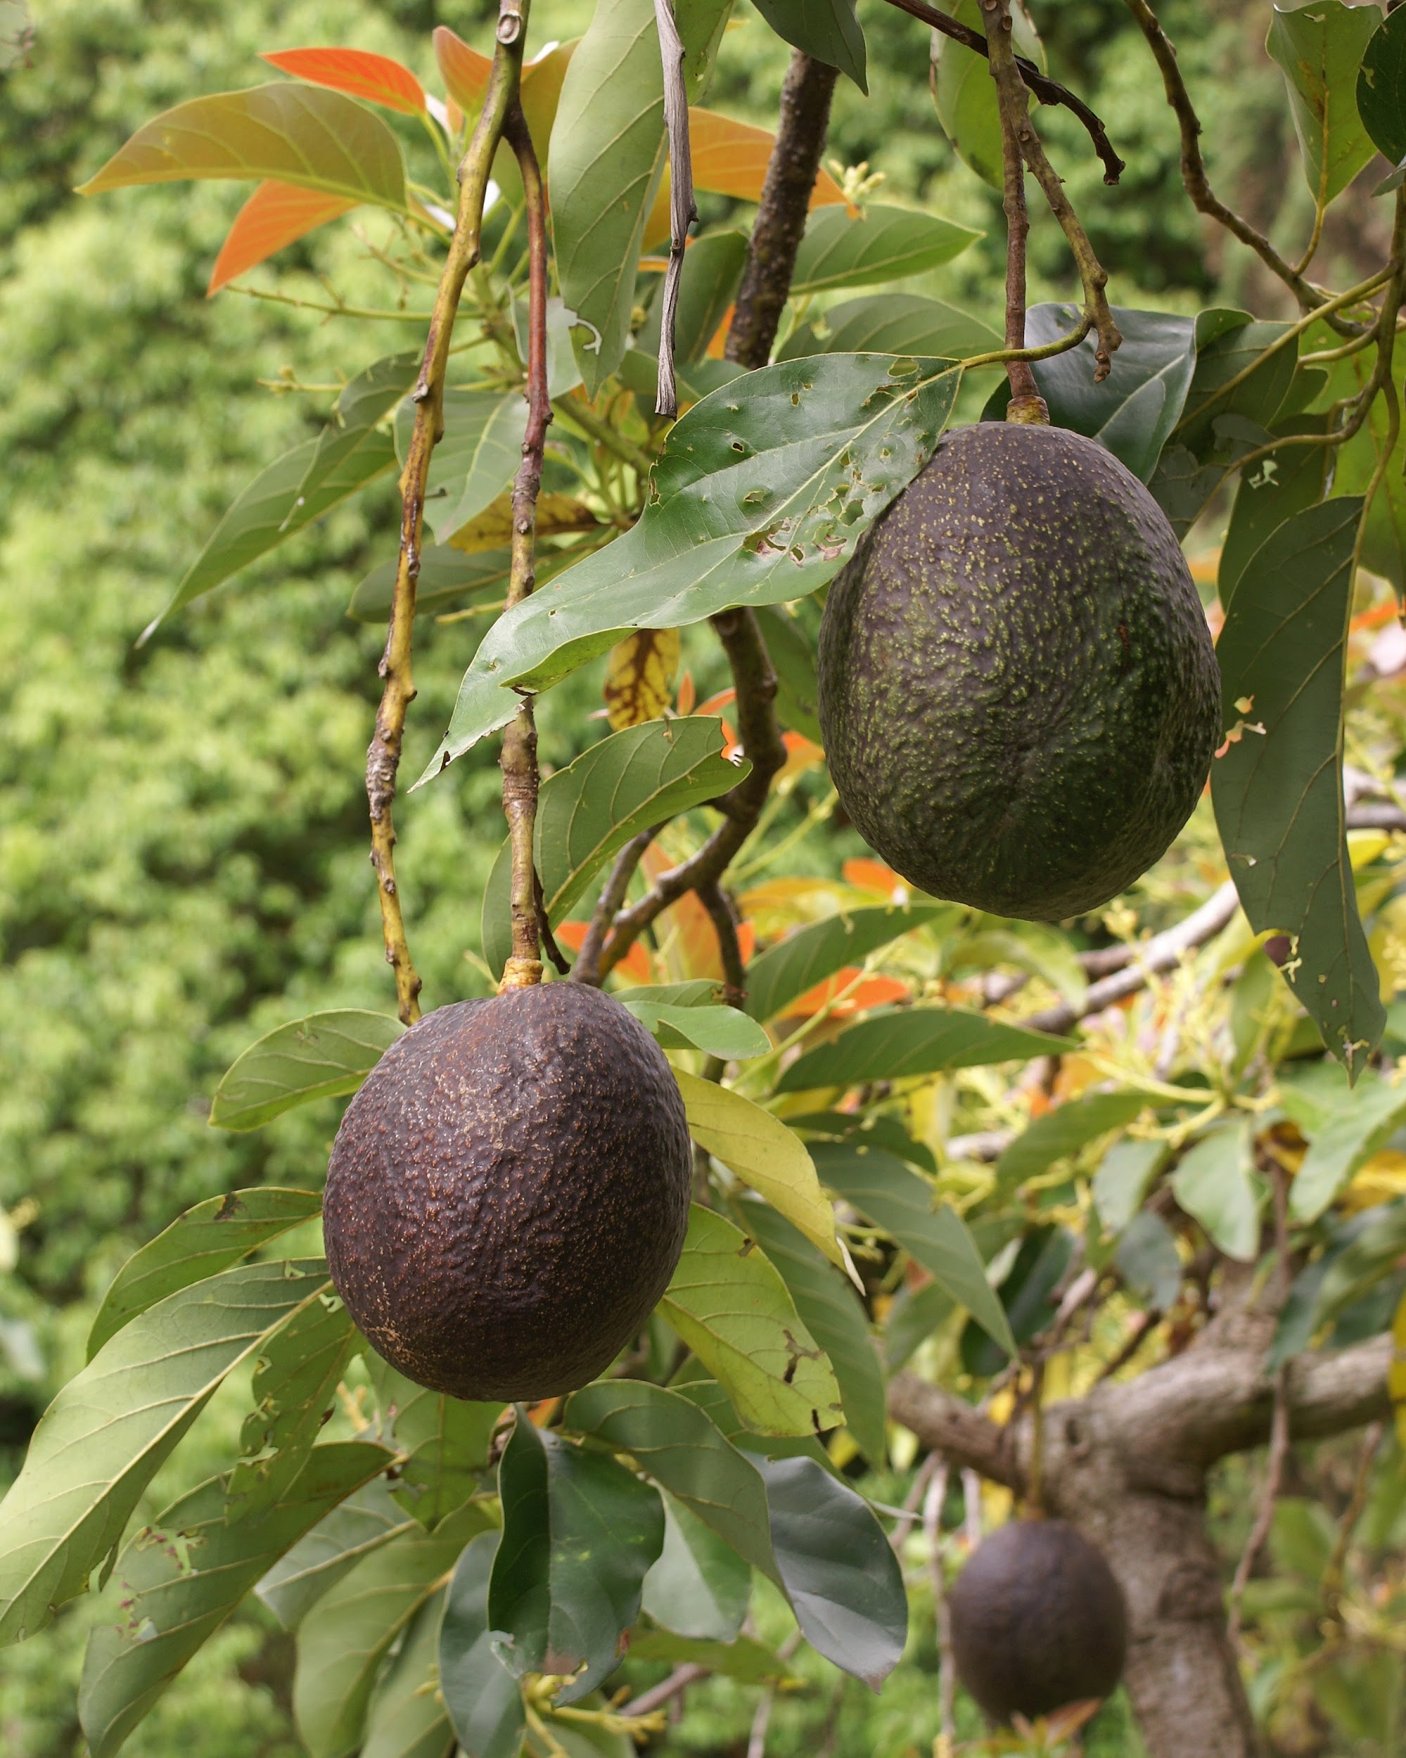
Methods
Data Wrangling
54 Regions (selected 3- Chicago, Columbus, & Tampa )
3 Years worth of data
4 Seasons
Organic and Non-Organic
Eliminated incomplete 2018 data
Create New variables
Created Cost Column
Created Seasons Column
Ave Price of Each Bag
Notes:
This project focuses on analyzing a sample of the total population of the US. As previously mentioned we selected 3 regions (Chicago, Columbus, and Tampa) from 54 Regions total. There was some descriptive data such as the season in which the avocados where grown as well as the type of avocados they were (Organic/Non-Organic). We were also able to deduct the total cost of the avocados purchased in each region, and the average price of each bag. The project will use statistical methods to identify patterns and relationships, if any, between various factors such as, consumption volume, consumer price, weather conditions(season), and total cost of consumption.

Slide 8
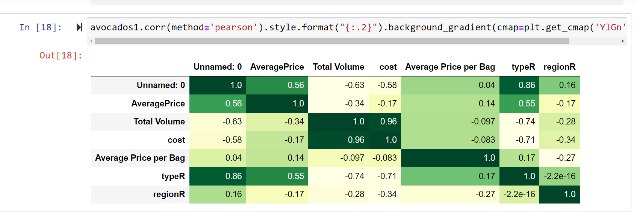
Pearson Correlation
Pearson Correlation shows the biggest correlation is between cost & total volume
Notes:
The only real correlation is cost and total volume, which makes sense because the more you produce, the higher your costs!

Slide 9
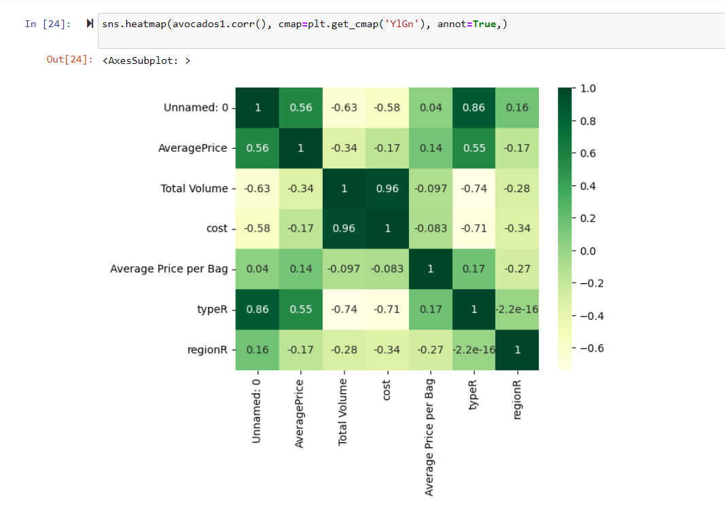
THE HEAT MAP SHOWS THAT THERE ISN’T A SIGNIFICANT CORRELATION BETWEEN VARIABLES EXCEPT FOR THE TOTAL VOLUME & COST- WHICH IS TO BE EXPECTED
HEAT MAP
Type R (organic) shows a variance worth investigating
Notes:
When we look at the heatmap & there isn’t a correlation accept for what is expected ~costs go up with the volume & slight variance within organic type

Slide 10
RESULTS- THERE IS NO REAL UNEXPECTED SIGNIFICANT CORRELATION FOR THE CONTINUOUS VARIABLES

Slide 11
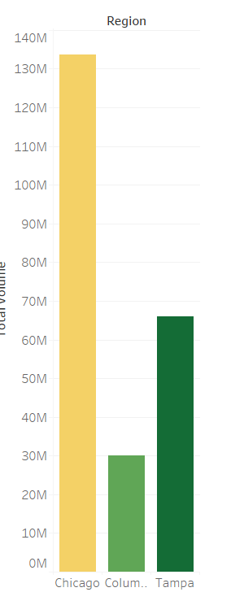
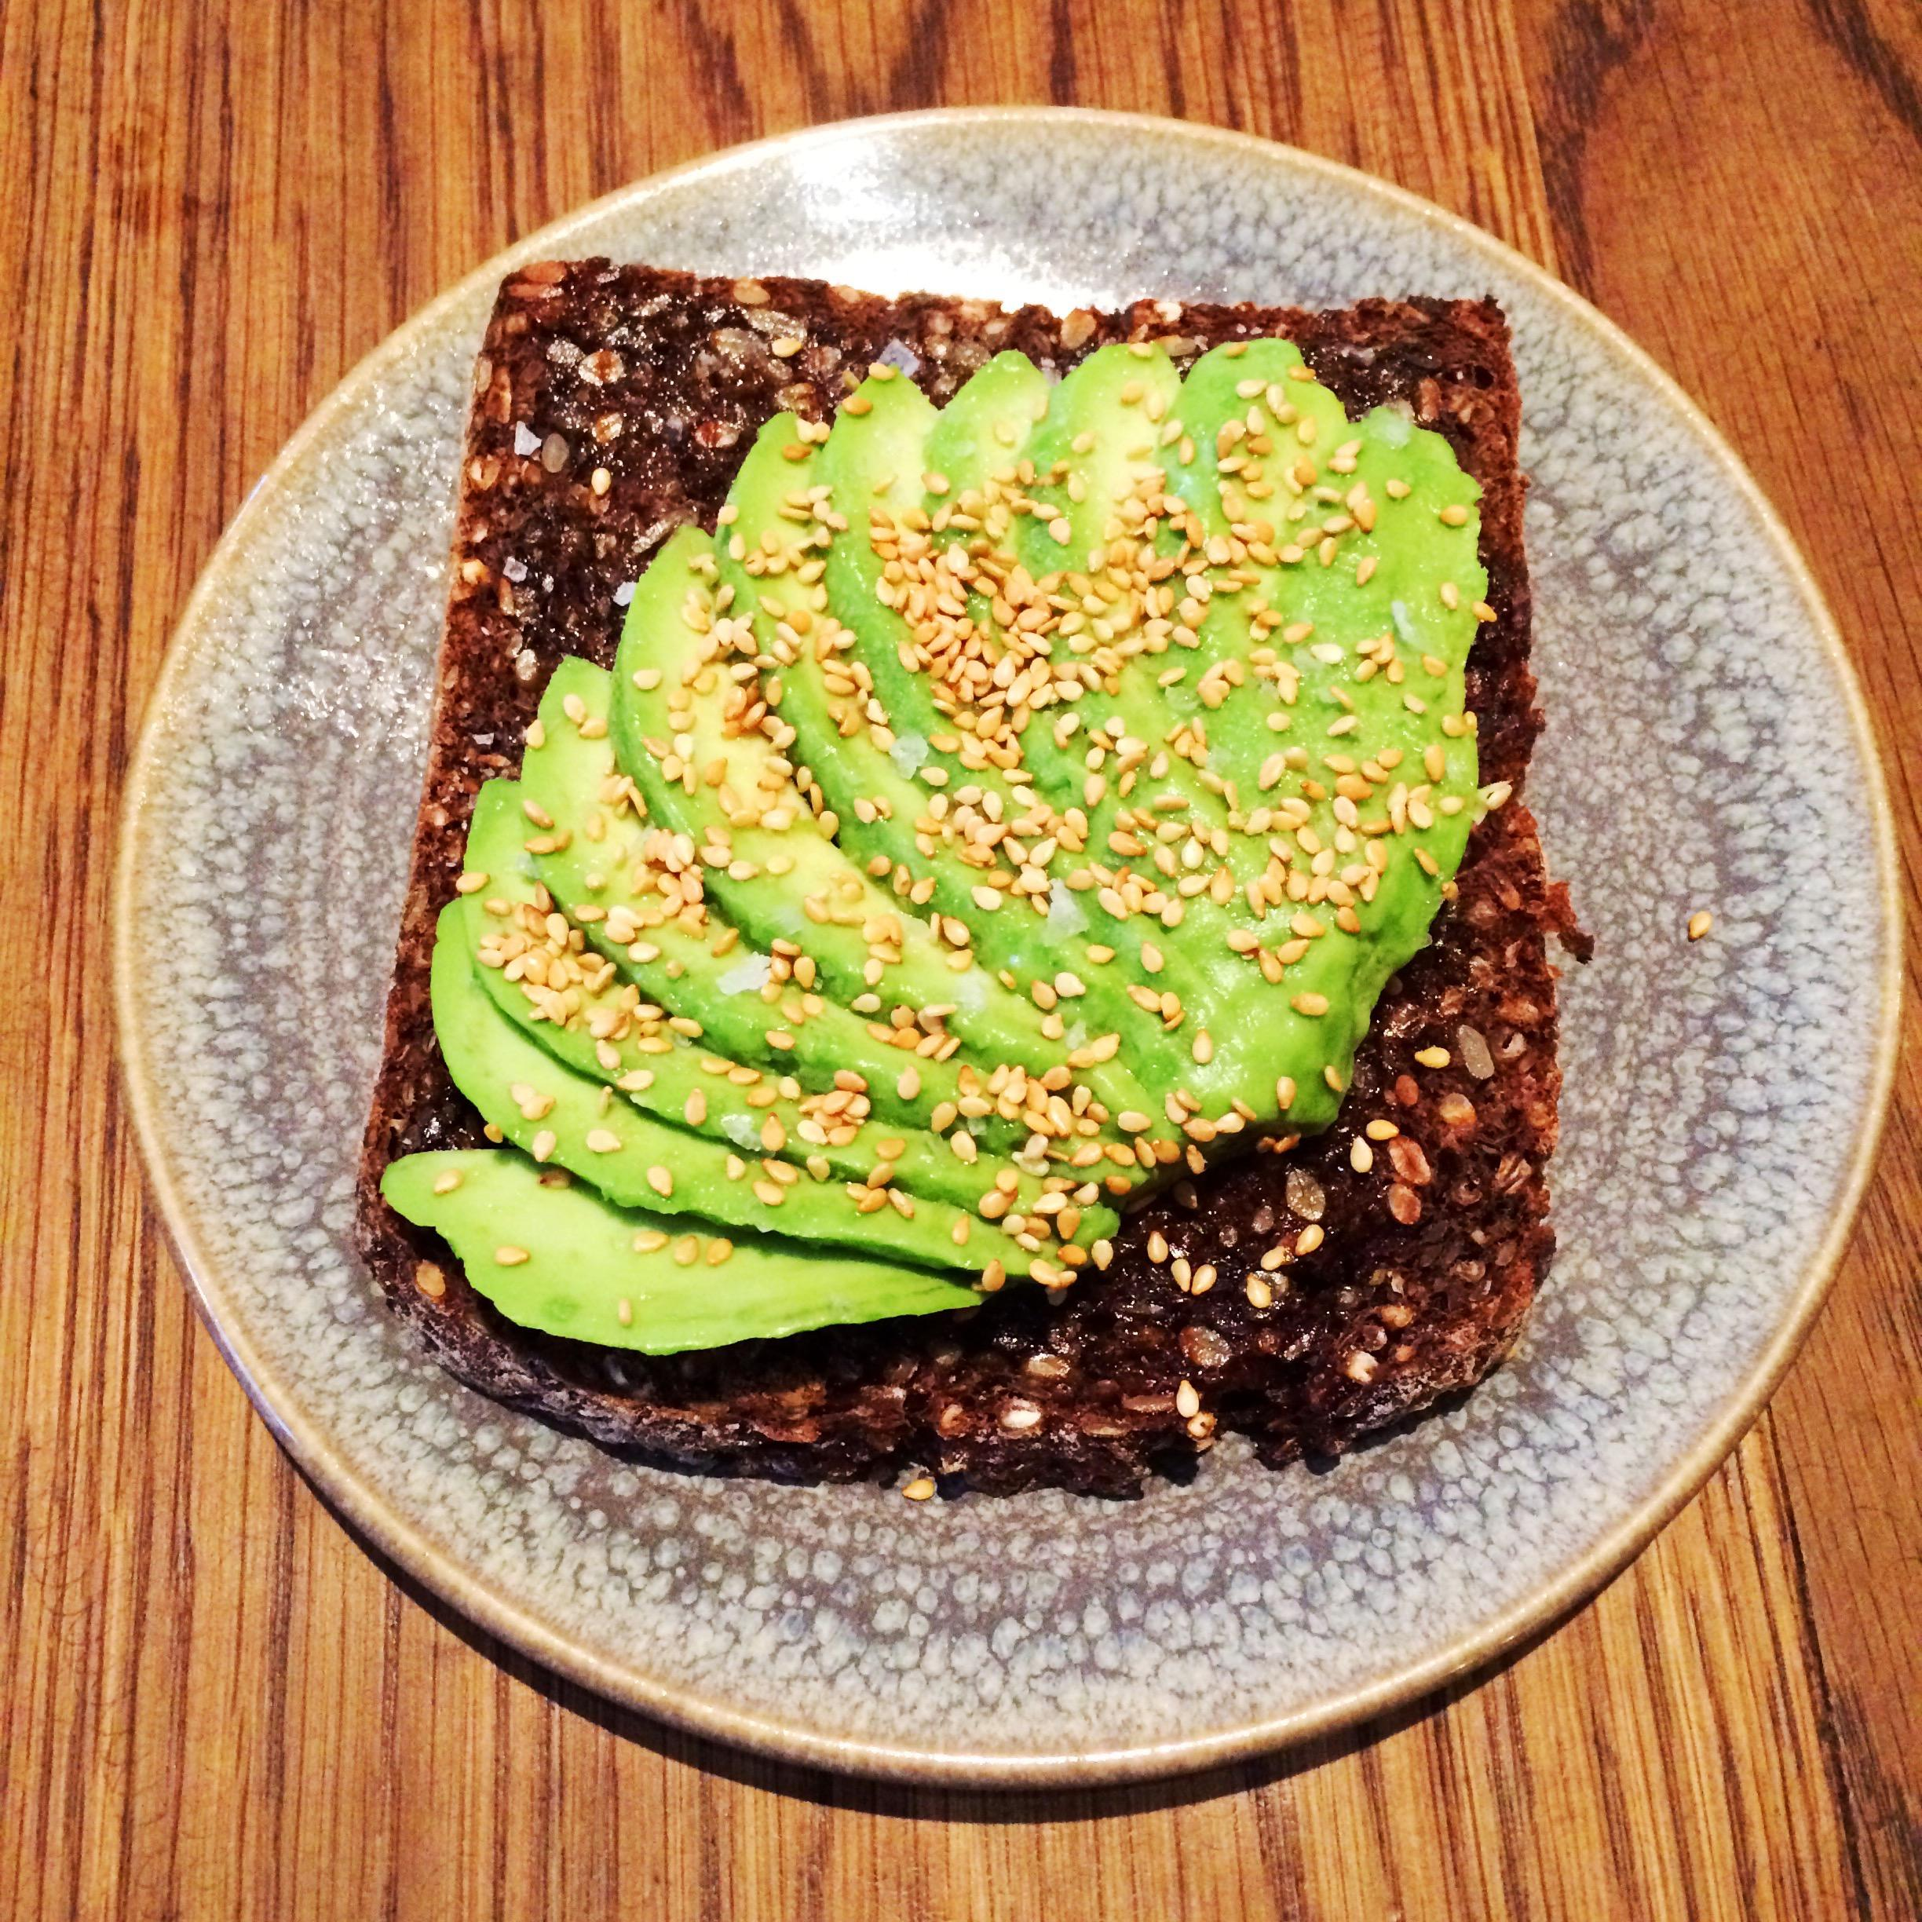
ANOVA
RESULTS-
RESULTS FROM ANOVA SHOW THAT CHICAGO CONSUMES 4 TIMES AS MANY AVOCADOS AS COLUMBUS, AND TWICE AS MANY AS TAMPA.
Notes:
When we did our ANOVA on the three cities we discovered that the Total Volume for Chicago 135 million- was more than 4 X more than Columbus at 30 million & Chicago was 2X as much as Tampa at 65 million.

Slide 12
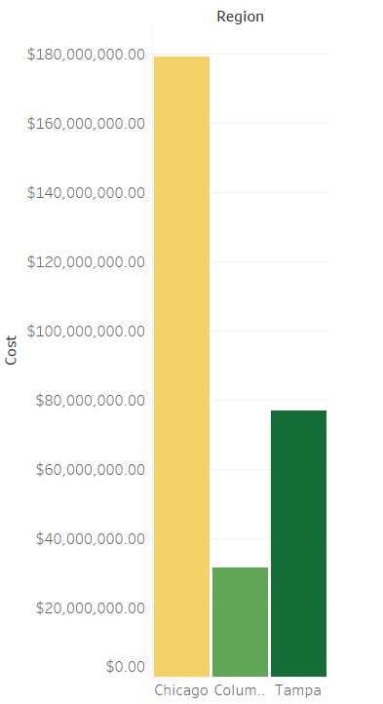
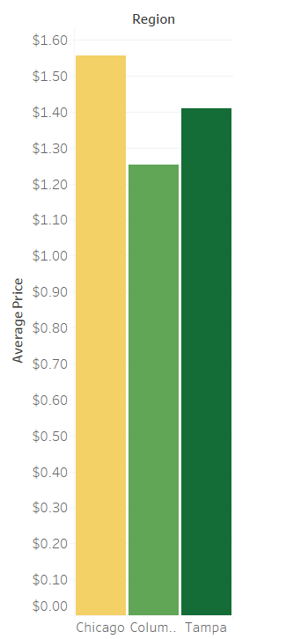
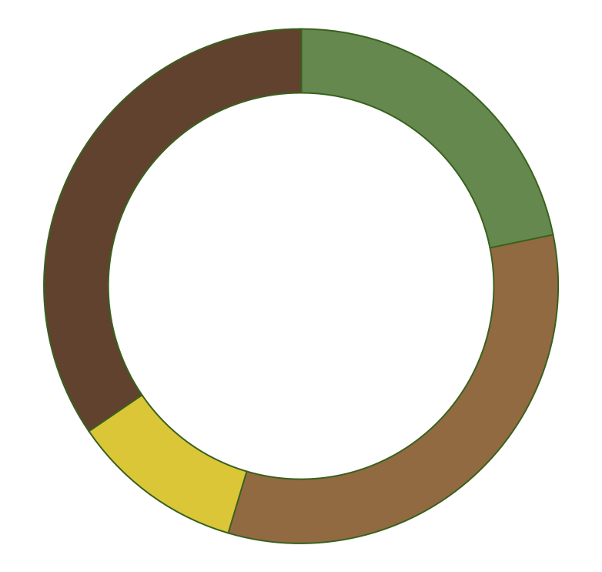
Compare Costs
$1.55
$1.40
$1.35
Compare Average Price
Notes:
Here we compare costs & price of the three cities & there is nothing with a large significant variance here.

Slide 13
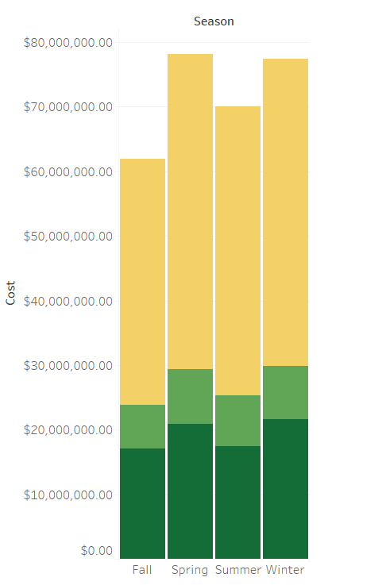
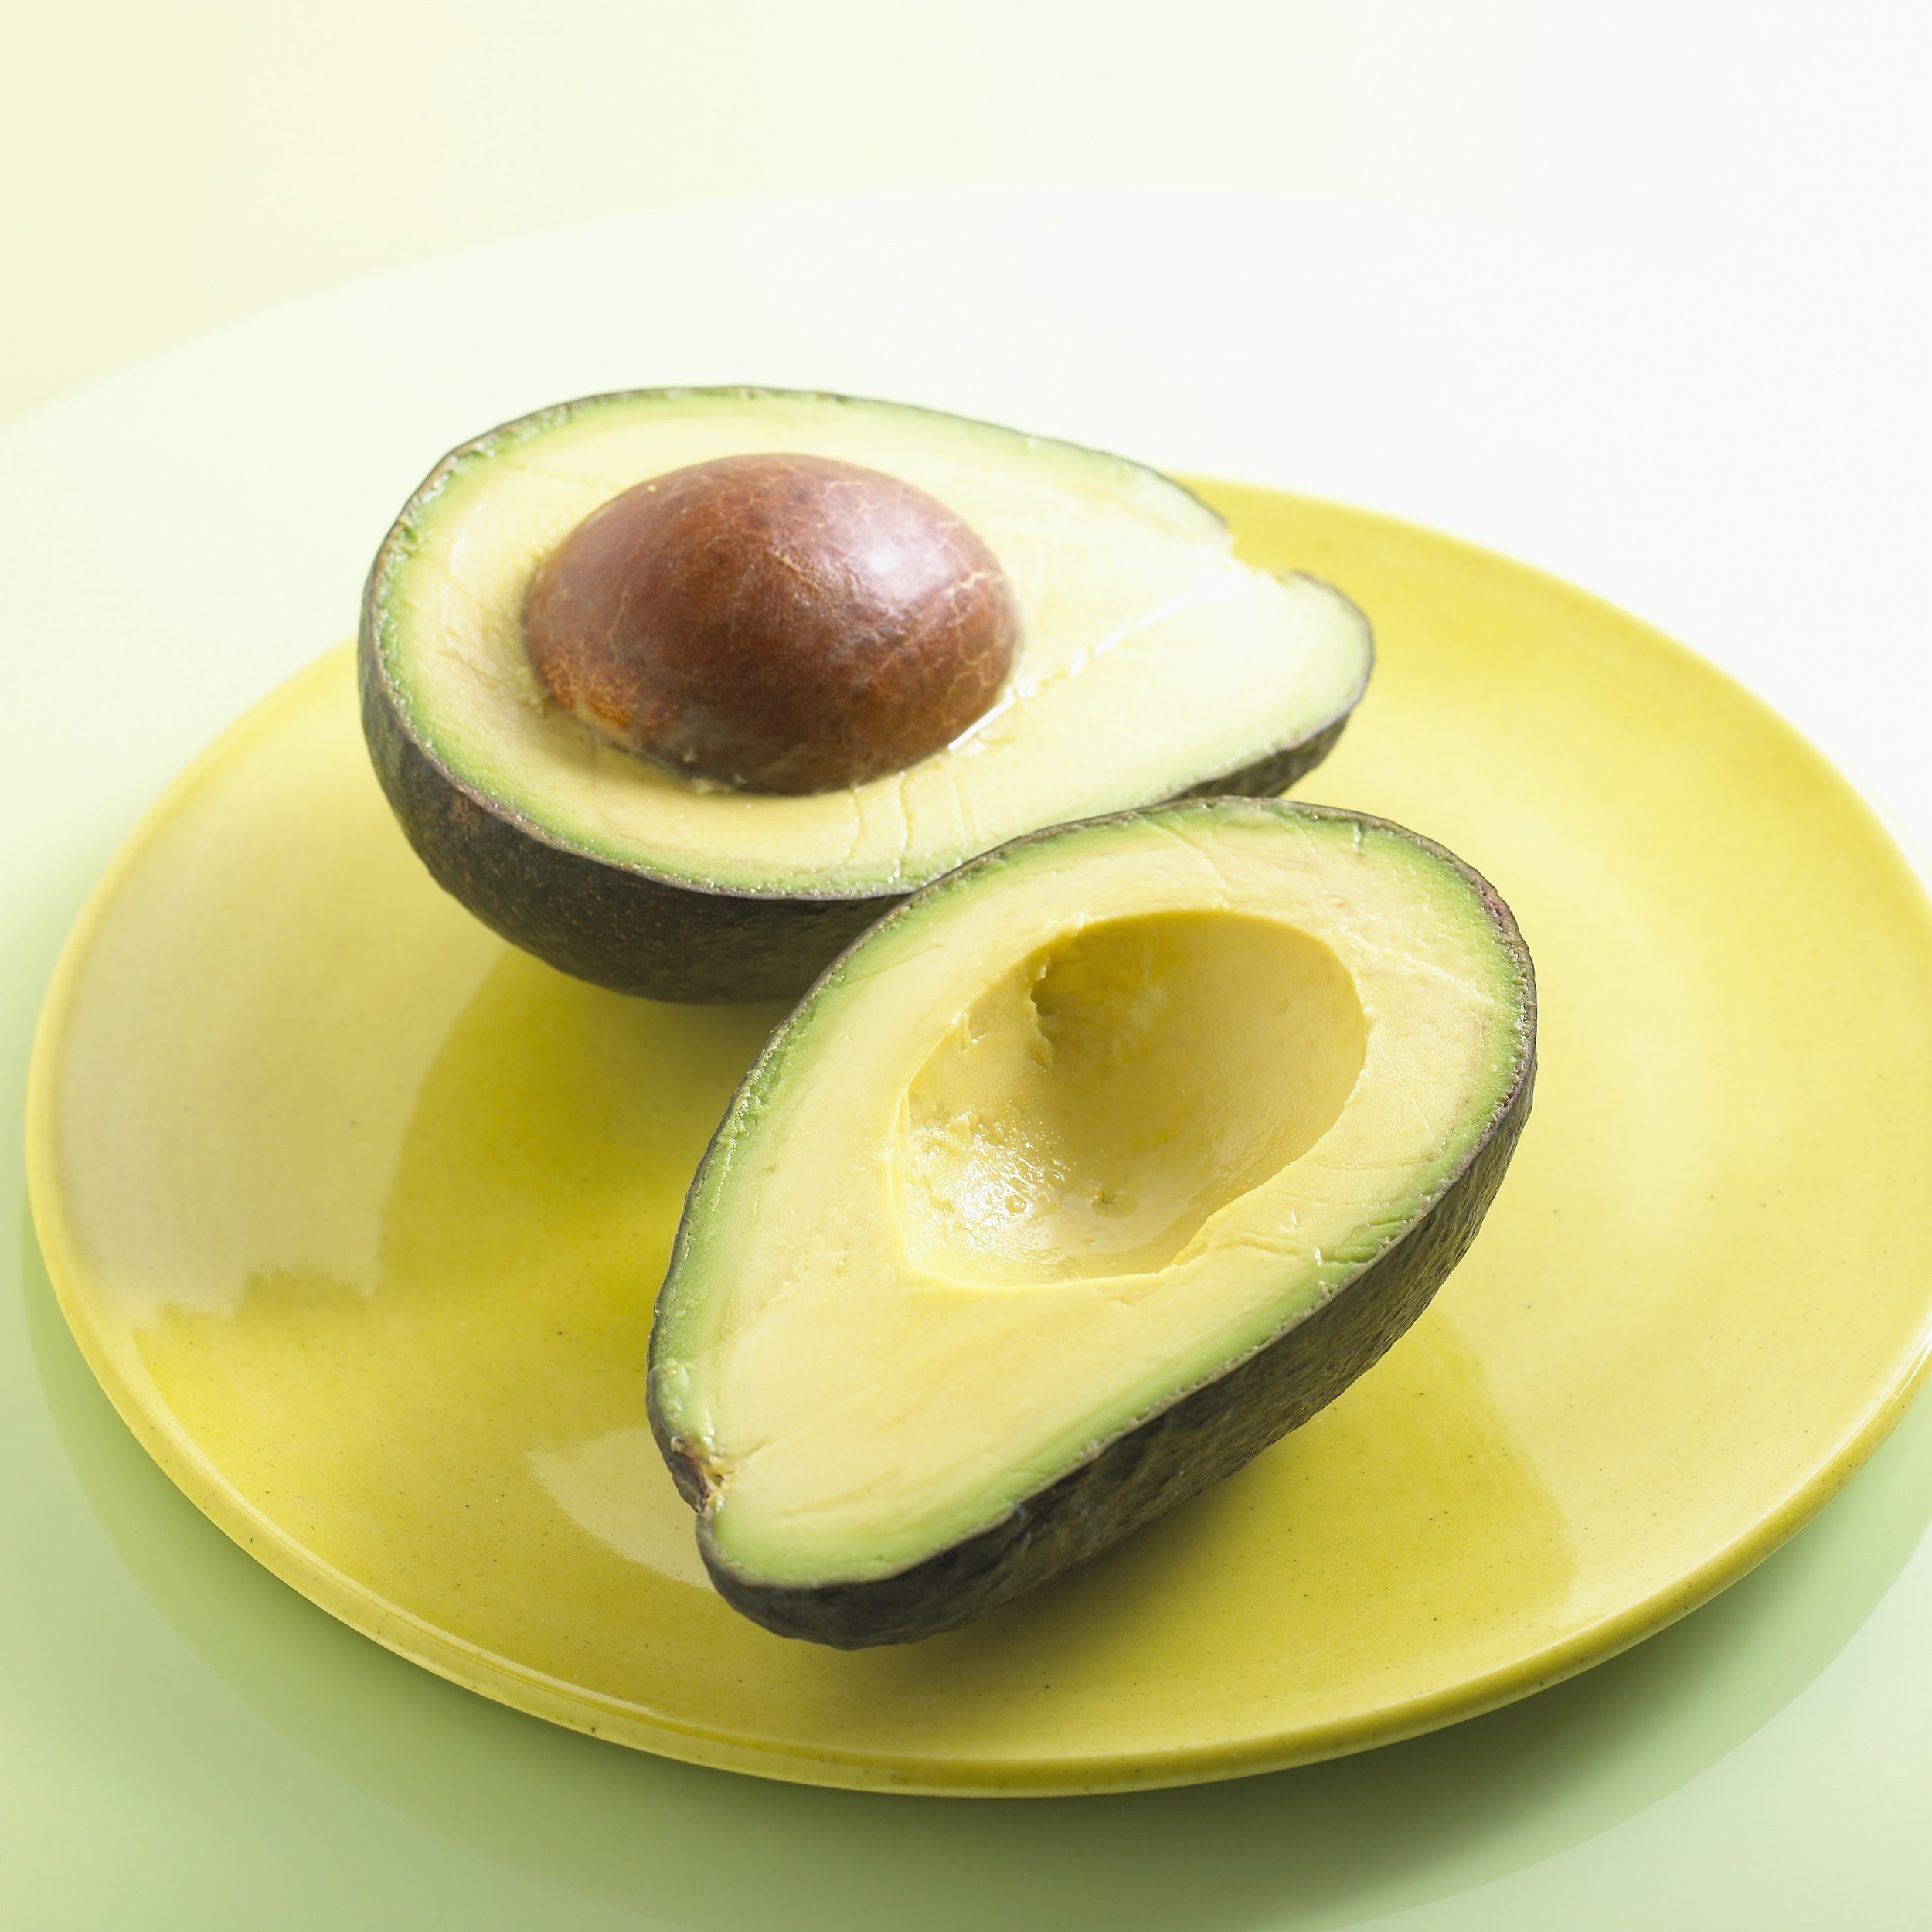
Costs compared by seasons
Notes:
The ratios between cost, total volume during the four seasons are surprisingly pretty consistent. The ratio consistently correlates to total volume.

Slide 14
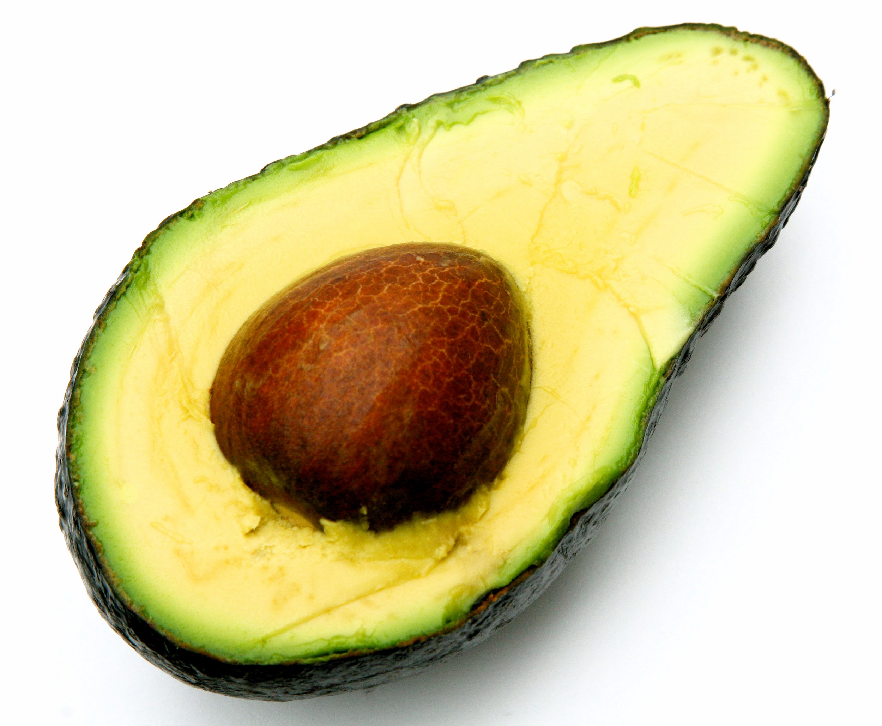
SURPRISE!
RESULTS- THERE REALLY IS LITTLE FLUCTUATION BETWEEN THE RATIO BETWEEN DIFFERENT SEASONS’ COST
& TOTAL VOLUME
Avocados grow in Mexico all year
Notes:
There was a false assumption there would be a greater variance during the four seasons…and after further research we learned that there are avocados being grown all year in Michoacan Mexico eliminating wide seasonal supply fluctuations and creating a pretty consistent supply every season.

Slide 15
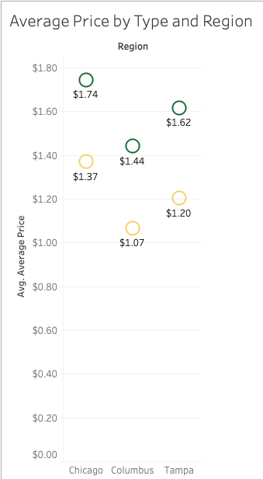
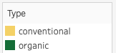
Independent T-Test
Here we can see the price of organic and non-organic avocados in each region
Notes:
Price differs between each region due to factors such as cost, volume, and demand -Jhae

Slide 16
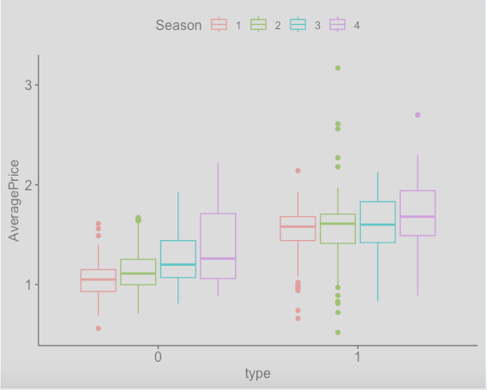
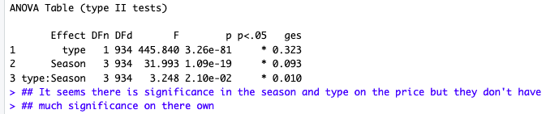
Two Way ANOVA
Here we can see how the type ( Organic or Non Organic ) and season effects the average price of avocados.
When looking at each side individually there isn’t much to see, but comparing both sides shows some influence of these variables on prices
Notes:
-Jhae

Slide 17
Growth!
The average price of avocados, increases by the season!
Notes:
With each season there’s an increase in price of avocados. With more research it was discovered that avocados grown in the winter months are easier to produce but harder to transport. This is because avocados are mostly produced in mexico where they can flourish throughout the late year months, meanwhile half of the US is covered in snow! . - Jhae

Slide 18
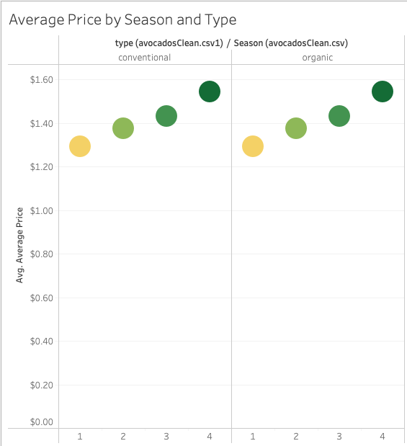
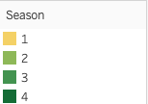
A Quick Look Into The Growth
Notes:
Here’s a visual of the increase in price. It’s not much, and is relatively consistent. - Jhae

Slide 19
Target Market!
Chicago is one of the largest avocado markets!
Notes:
With Chicago being one of the largest markets for avocados, a new distributor or avocado connoisseur may want to pay keen attention to the trends in the city as it’s consumption of avocados is a unique one. This could potentially be the ground site for an atomic launch of a new avocado business where one could indulge or invest successfully - Jhae

Slide 20
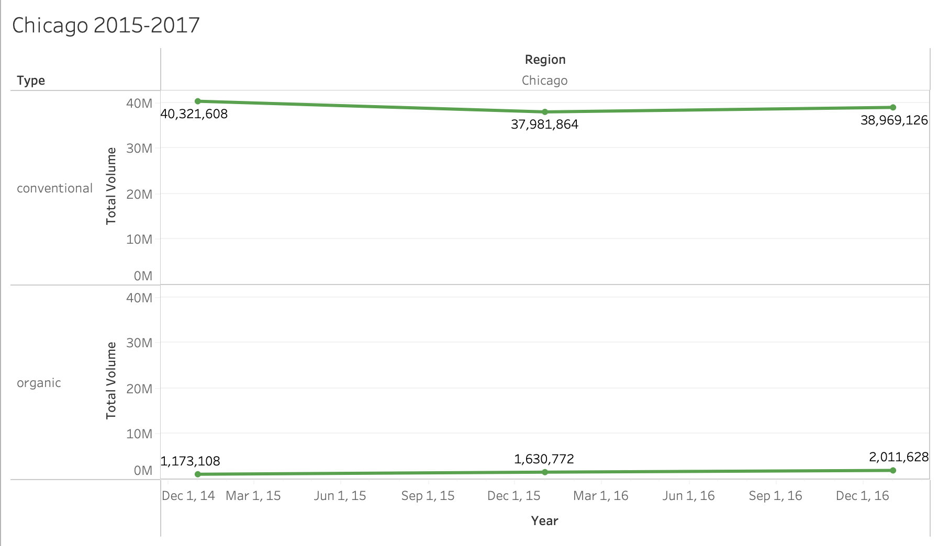
Chicago Conventional and Organic Volume

Slide 21

Chicago Results
2015-2016
2016-2017
2015-2017
Conventional
Significant difference. (decrease)
Organic
Significant increase
Conventional
No significant difference
Organic
Significant Increase
Conventional
No significant difference
Organic
Significant increase

Slide 22
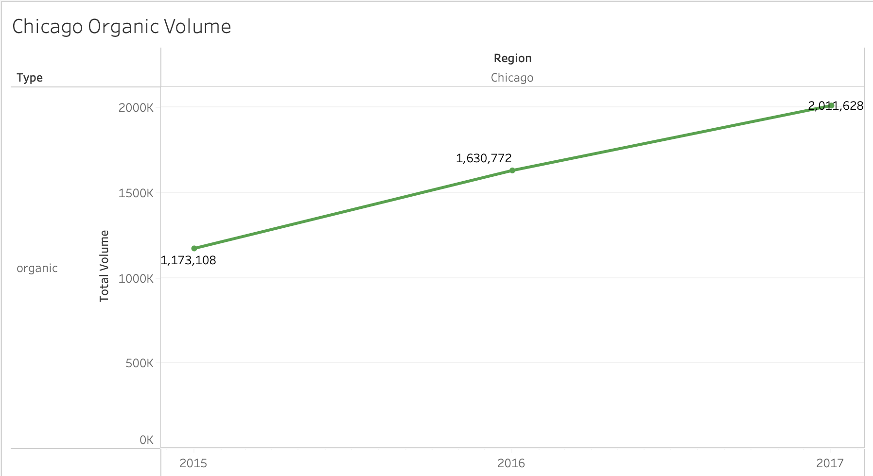

Slide 23
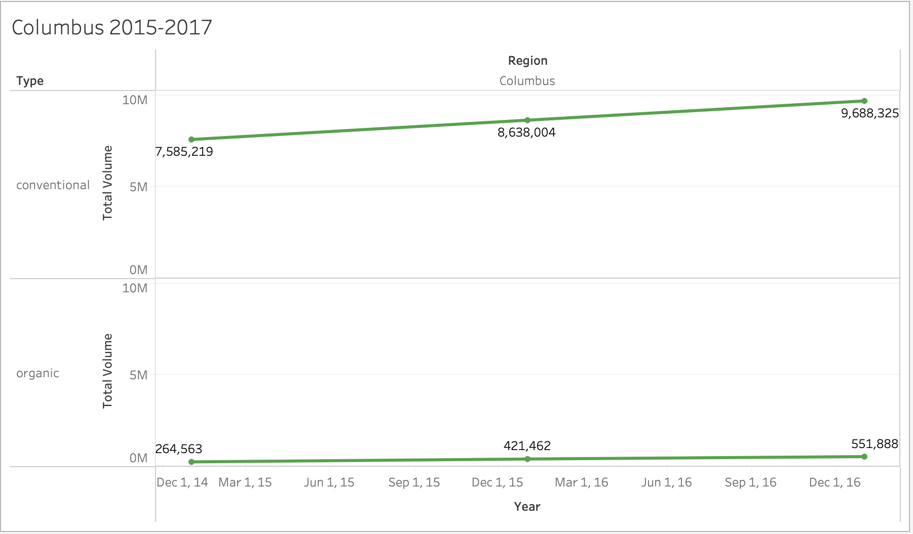
Columbus Conventional and Organic Volume

Slide 24

Columbus Results
2015-2016
2016-2017
2015-2017
Conventional
Significant Increase
Organic
Significant Increase
Conventional
Significant Increase
Organic
Significant Increase
Conventional
Significant Increase
Organic
Significant Increase

Slide 25
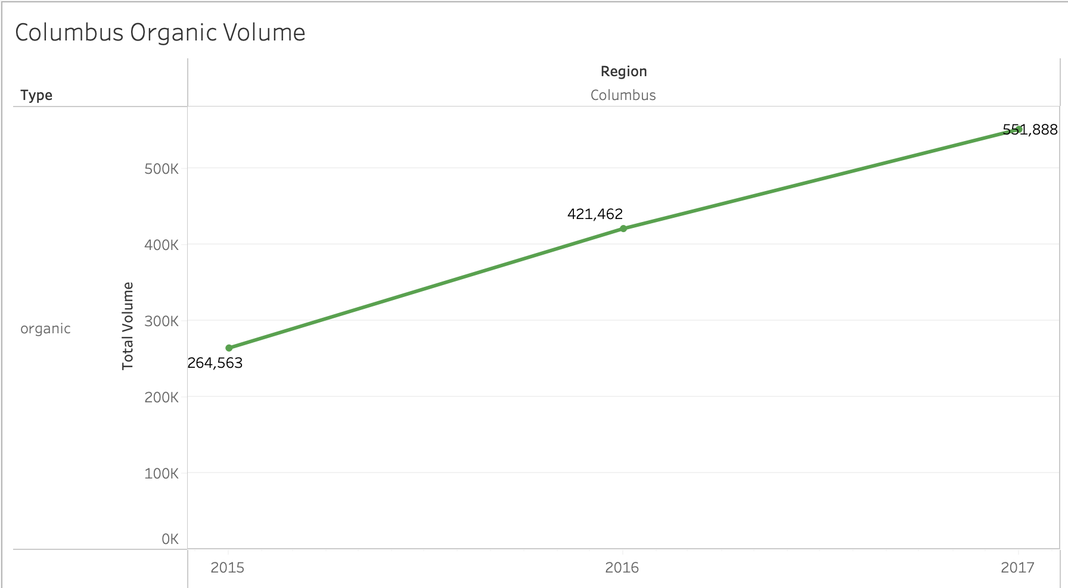

Slide 26
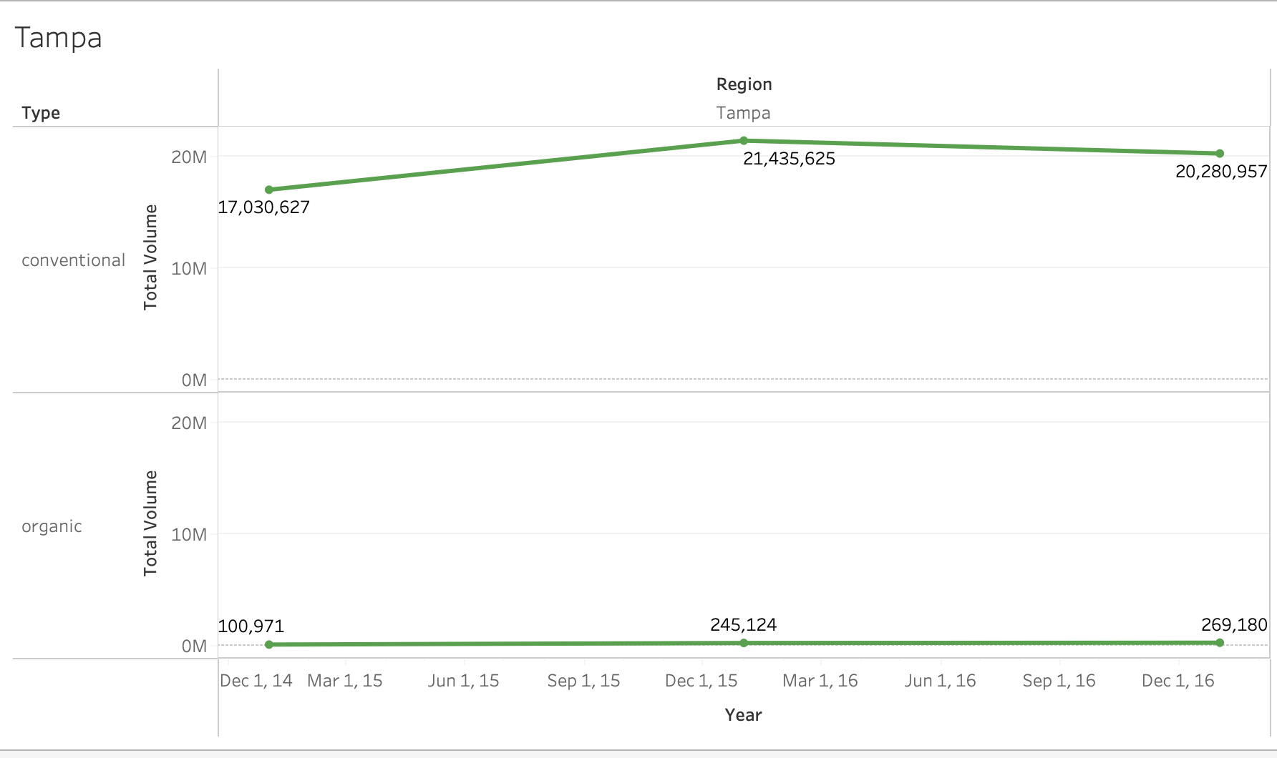
Tampa Conventional and Organic Volume

Slide 27

Tampa Results
2015-2016
2016-2017
2015-2017
Conventional
Significant Increase
Organic
Significant Increase
Conventional
No Significant Change
Organic
No significant change
Conventional
Significant increase
Organic
Significant increase

Slide 28
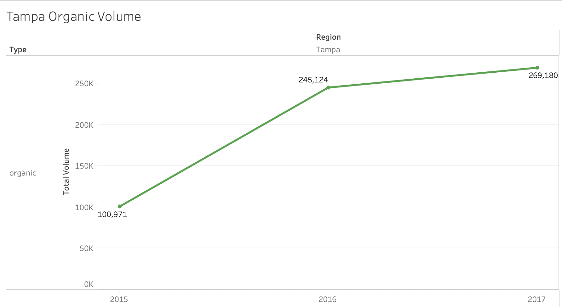

Slide 29
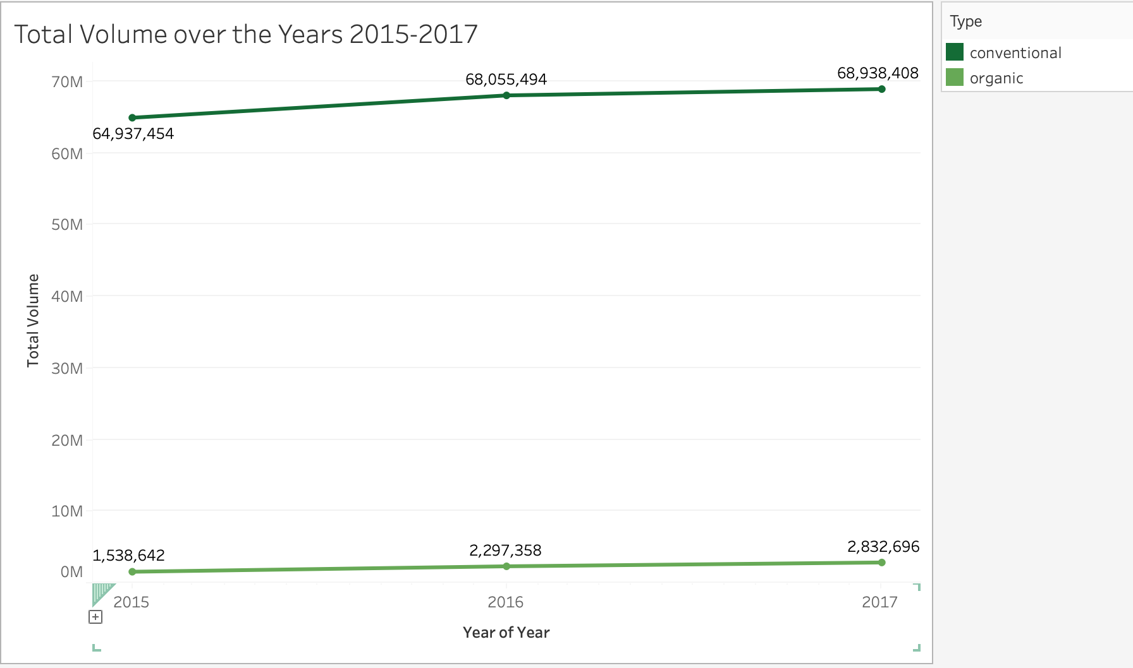
Conventional and Organic Over all 3 Cities

Slide 30
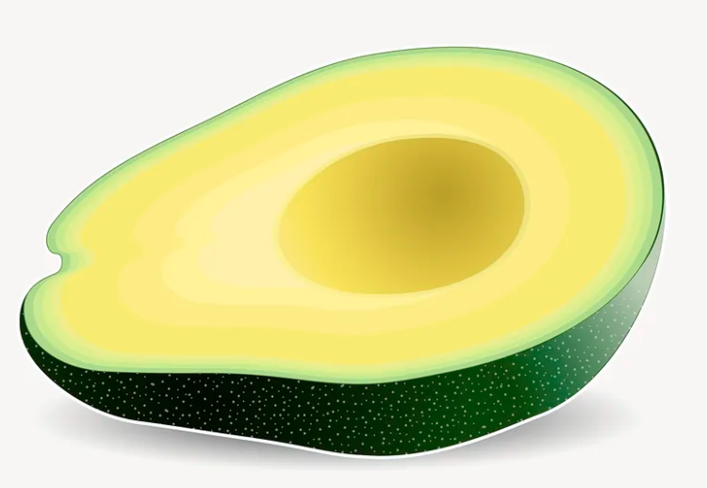
3 Cities Combined
2015-2016
2016-2017
2015-2017
Conventional
No significant change
Organic
Significant increase
Conventional
No significant change
Organic
Significant increase
Conventional
No significant change
Organic
Significant increase

Slide 31
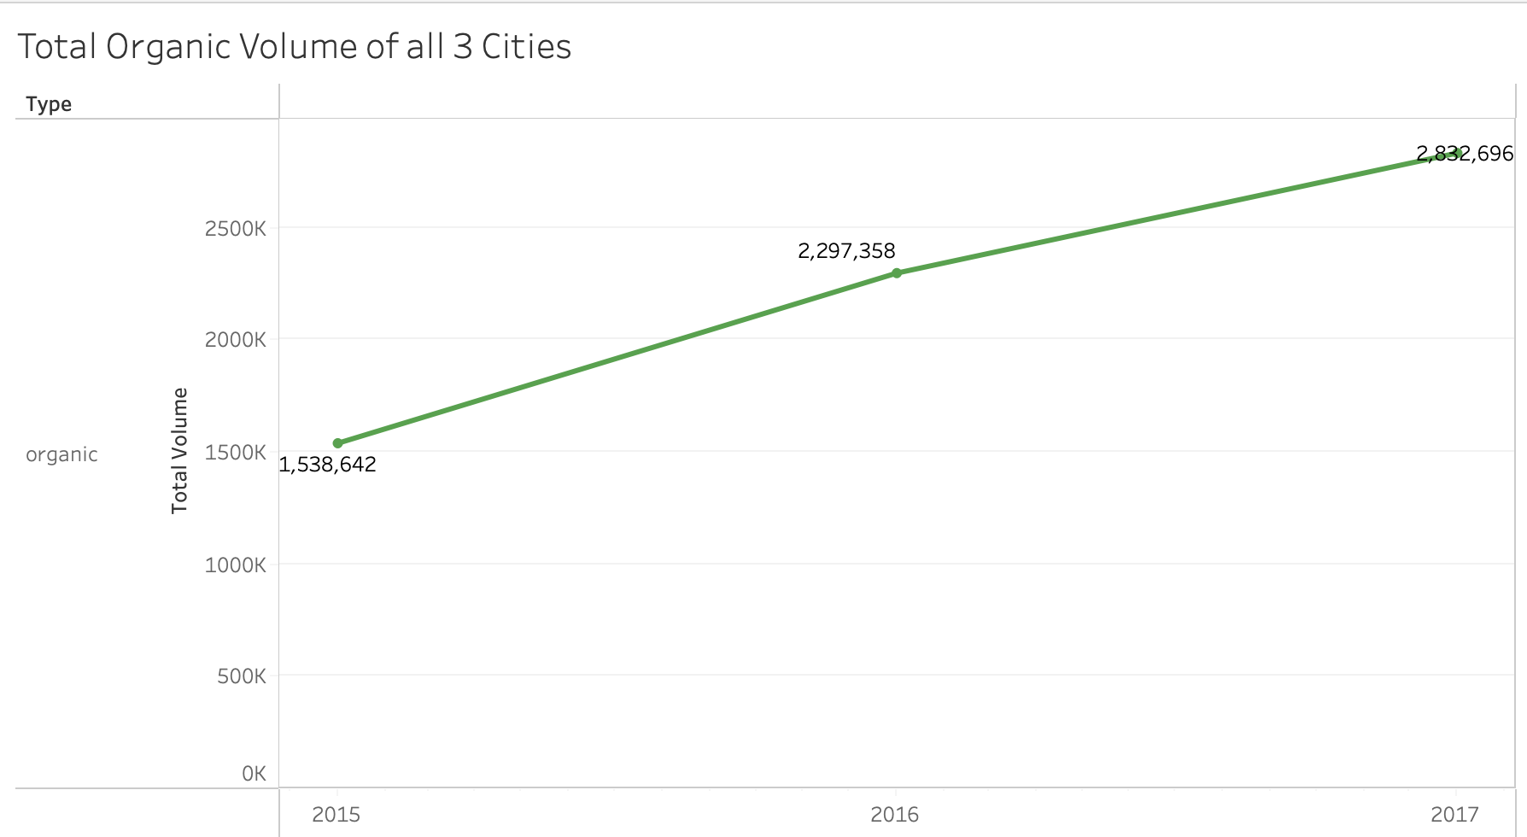

Slide 32

Summary
IN ALL 3 CITIES, ORGANIC CONSUMPTION HAS SEEN A SIGNIFICANT INCREASE
Chicago has proven to be one of the largest markets for avocado sales.
If a new distributor was looking to build revenue quickly, Chicago would advised- selling organic avocados, during a high volume season.
COSTS AND SALES ARE SOMEWHAT STABLE ALL YEAR DUE TO ANNUAL GROWING SEASON
BUT THE AVOCADO MARKET COULD ALSO BE EXTREMELY VULNERABLE BECAUSE NEARLY 90%* OF AVOCADOS SOLD IN AMERICA COME FROM “LAVACADOS”
* ACCORDING TO NY TIMEShttps://www.nytimes.com/2018/03/27/magazine/the-fruit-of-global-trade-in-one-fruit-the-avocado.html
Notes:
The findings of this project have important implications for avocado producers, traders, and retailers, as well as for consumers who are interested in understanding the dynamics of avocado prices.We hope that the insights gained from these analyses’ will contribute to a more stable and sustainable avocado industry, benefiting all stakeholders involved!

Slide 33
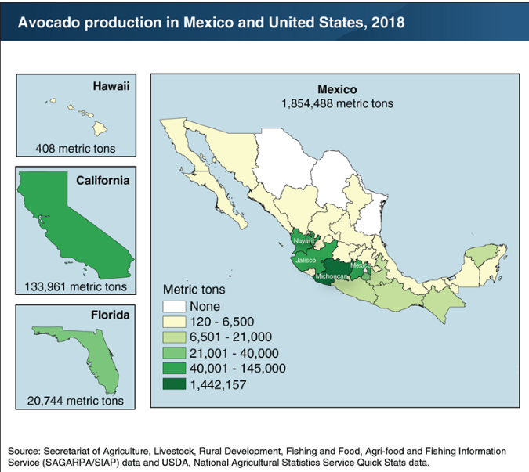
Michoacan territory =
71% of all avocados grown are grown here
Michoacan is smaller than the state of West Virginia
Notes:
One last thing to note and a short reminder that avocado production in the US is a very recent growth. Most of the avocados consumed here are grown in “Lavacados” Michoacan, Mexico. This chart shows the distribution of avocados produced in the US & Mexico in 2018. “Lavacados” is the nickname of this territory where avocados reign surrounded by over 100 volcanos.

Slide 34
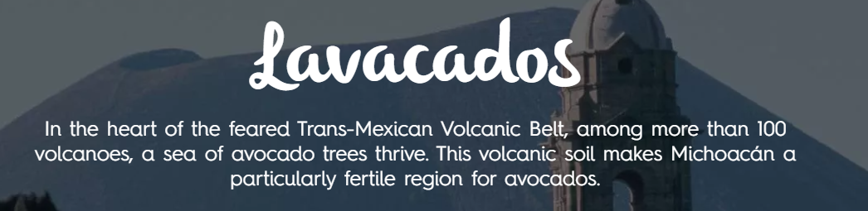
Conclusions
Organic consumption is increasing
Chicago is a great city for selling avocados!
SUPPLY FROM LAVACADOS MEXICO IS THE BIGGEST VARIABLE AFFECTING THE AVOCADO MARKET IN THE U.S.
Notes:
With demand ever increasing, it might be wise for US farmers to expand their avocado production.

Slide 35
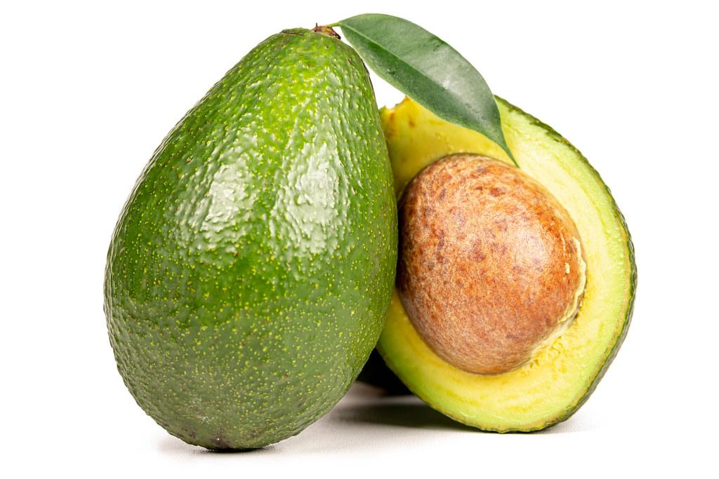
QUESTIONS?

